Slide 1
Emerging Technology Business Concept : Graphene
Nancy Bota | Ethan Coppenrath | Danying Li | Michael Manning

Slide 2
Agenda
Introduction to Graphene
Current Applications of Graphene
Overview of Kayvan Rafiee’s Graphene Manufacturing Process
Potential Applications of Graphene
Graphene Competitor
Challenges & Hurdles Going Forward

Slide 3
Introduction to Graphene
Researched throughout the 1990’s
First Graphene lattice produced in 2004 by Andre Geim
Tape Proccess
2010 Nobel Prize
1 Atom thick hexagonal lattice of carbon atoms
“nano-scale chicken wire”
Strongest material ever tested
200 times greater breaking point than steel
High electron mobility

Slide 4
Kayvan Rafiee
Born and Raised in Tehran, Iran
BS and MS in Mechanical Engineering at The University of Tabriz
MS in Industrial Management & Engineering at RPI
Currently working on PhD in Mechanical engineering at RPI
Enjoys larger graphene research community
Nobel Prize 2010
Extremely humble
Well versed in commercialization
Motivated by money

Slide 5
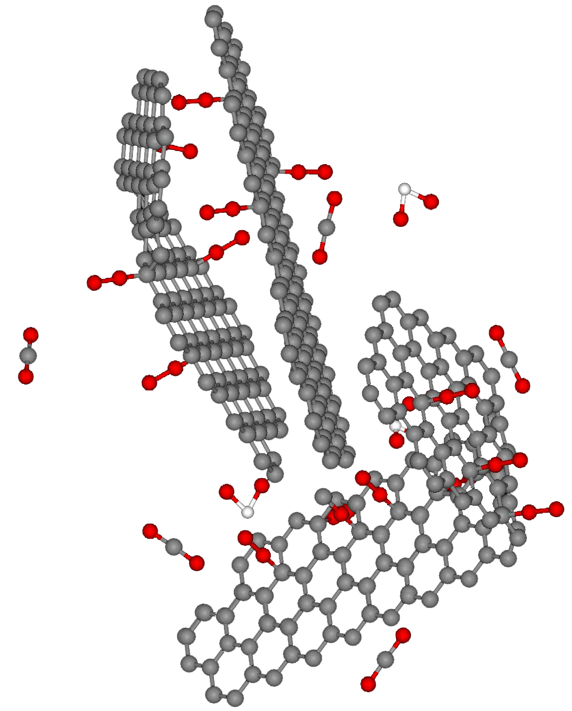
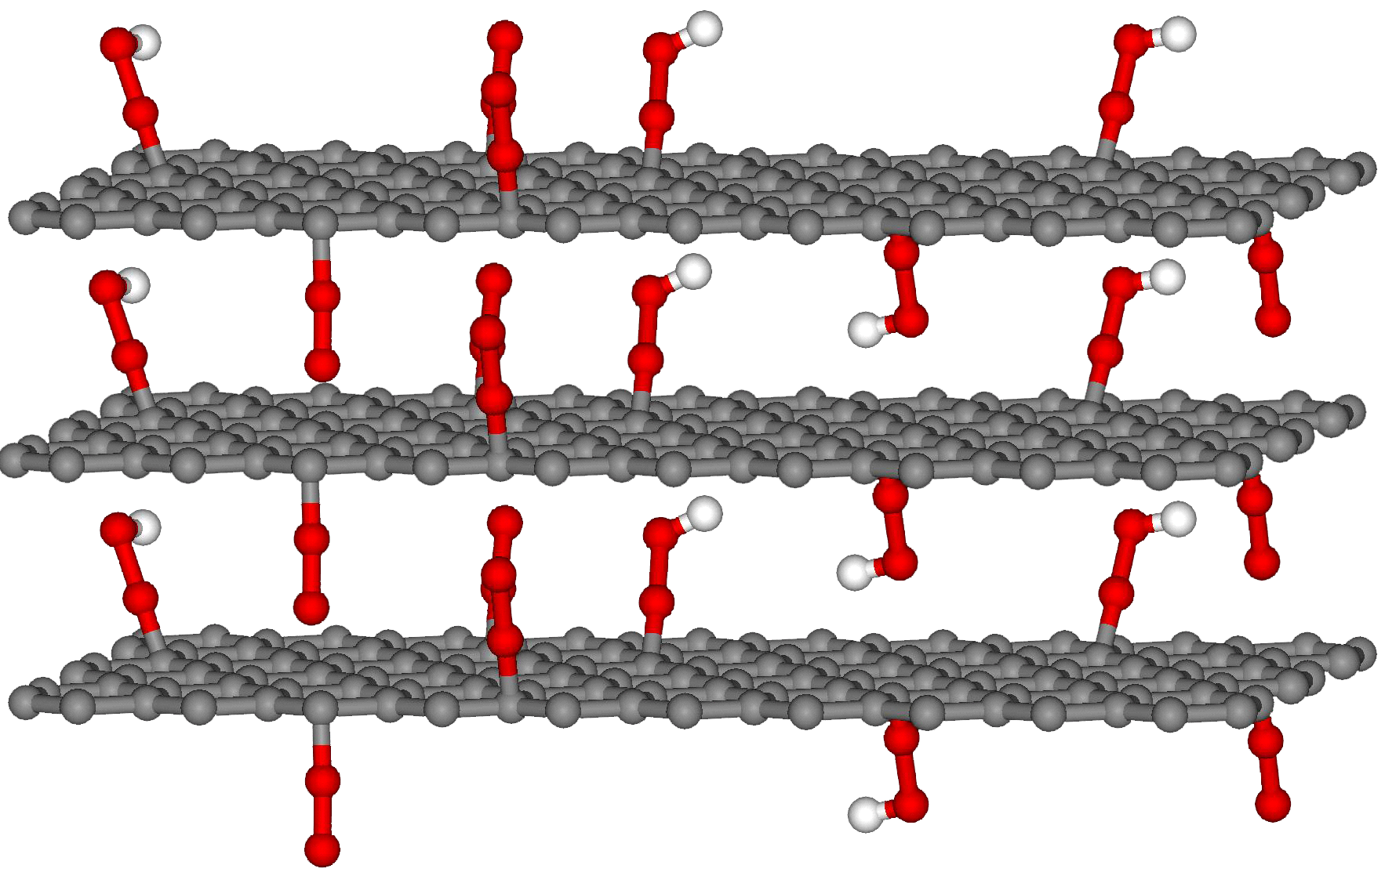
Overview of Kayvan’s Process
Graphite
Graphene Platelet (GPL)
0.34 nm
0.34 nm
HNO3
H2SO4
KClO3
Oxidation (4 days)
2000 °C/min
Thermal Shock
0.71 nm
0.71 nm
Graphite Oxide
Aksay and coworkers, Chemistry of Materials, 2007
Notes:
Graphite is oxidized. Graphite oxide is put through thermal shock. Expansion makes layers separate and creates thin mulit-layer graphene

Slide 6
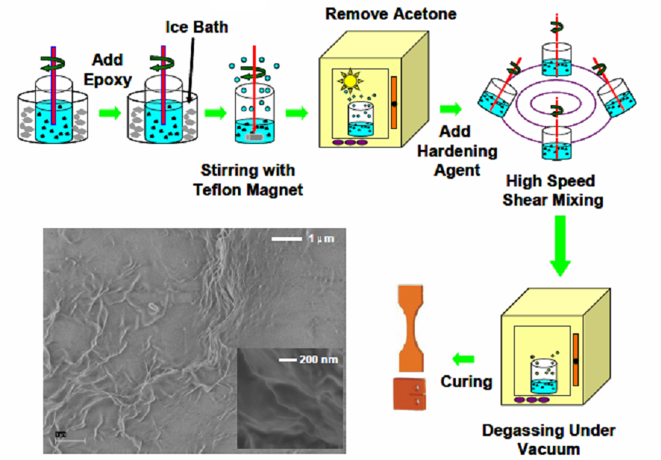
Compositing Process
M.A. Rafiee et al, Applied Physics Letters, 2009 & J of Nanoparticle Research, 2010

Slide 7
Current Applications of Graphene
Properties of graphene: Strong, extremely light, optical transparency, electric conductivity
Hurdles for current application: difficult and expensive for mass production
Perfect graphene: sensor, integrated circuit interconnects, transparent conducting electrodes.
Graphene composites
Aerospace
Automotive
Notes:
Stronger than diamond, most conductive material currently known
transparent conducting eletrodes like touch screen

Slide 8
Potential Applications of Graphene
Body Armor
Sporting Goods
Prosthetics
Energy

Slide 9
Body Armor
$5.2 Billion in contracts between 2004 and 2006
Ceradyne, Armor Works, and Simula Inc.
Testing based on kinetic energy impact
Velocity is primary variable in testing (V50 Test)
‘Ice Pick Test’
4 Classes of armor
Current Kevlar (Protera) released in 1996
M5 Fiber in development
Nano infused fibers
BAE Systems licensed similar technology
US Army already expressed interest in carbon nano-tube vests developed at the University of Cambridge
Use Graphene to create nano-infused fibers for body armor
Notes:
Testing: usually tested by stopping 3 medium strength rounds and then pentrated by 1 high velocity round to determine strength
Current armor is Kevlar fiber

Slide 10
Sporting Goods
$12 billion dollar industry
Zyvex uses graphene to produce baseball bats for Easton
Reduced failure by 300%
Testing based on amount of energy to failure
“Number of hits to failure”
Carbon nanotube infused polymers currently used to make golf shafts
Graphene can be used to make golf club shafts more flexible, stronger, stiffer, and lighter
Notes:
While adding material to sporting goods may improve their ability to resist wear, absorb impacts, dampen vibrations, or perform other advantageous functions, it may also add bulk and weight to the sporting goods. Currently, carbon nanotube fibers are used in sporting equipment, but graphene can allow improved handle designs with optimized flexibility, responsiveness, and strength.

Slide 11
Medical (Prosthetics)
Graphene composites infused: stronger, stiffer, and less prone to failure.
Prosthetics: the development and production of replacements for missing body parts e.g. teeth & limbs.
Composites: Incorporated with 3D printing

Slide 12
Energy
Properties of graphene important to Energy industry
Lightweight, strong, flexable
Energy converters/turbines
Wind, hyndro, coal, gas, nuclear, etc.
Growing industry with more focus on “Green” and increasing our efficiencies
Domestic wind industry to grow 7x in the next 3 years to nearly $70 billion

Slide 13
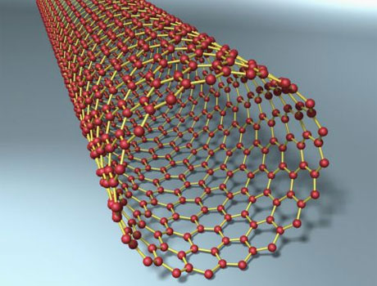
Graphene Competitors
Major competitor: Carbon nanotubes
Advantage 1 Wrinklt surface: interlock better with the surrounding polymer material
Advantage 2 Surface area: more contact with the host material than the tube-shaped carbon nanotubes
Advantage 3 Easier to make and manipulate
Notes:
wrinkly surfaces interlock well with the surrounding polymer material, helping to boost the interfacial load transfer between graphene and the host material.
top and bottom surfaces of the graphene sheet can be in close contact with the polymer matrix
thinnest of all possible materials in the universe.
shares many of the properties that with nanotubes, but it is easier to make and manipulate

Slide 14
Challenges & Hurdles
Producing a single layer of graphene inexpensively is the next step in graphene
Single layer with no defects has the greatest potential for alternative uses
Lack of 'band gap', a break in electron energy levels that would allow it to be easily used as a transistor
So thin, even the slightest brush from neighboring atoms can alter its mechanical and electrical properties
Health Effects (Asbestos Issue)
Notes:
Currently, a single layer is 3 times more expensive to produce than composite. A single layer with no defects has the greatest potential for alternative uses, especially in technology-related applications. Once the “band gap” issue is solved, graphene can be more widely adapted in electronics.

Slide 15
Thank You
Questions?

