Slide 1
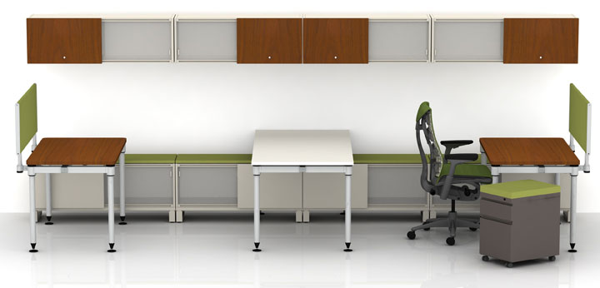
DMM Milestone 1 : Herman Miller
Jon Ashdown | Greg Frisch | Danying Li | Michael Manning | Kudzi Mugomba | Nadeem Omar

Slide 2
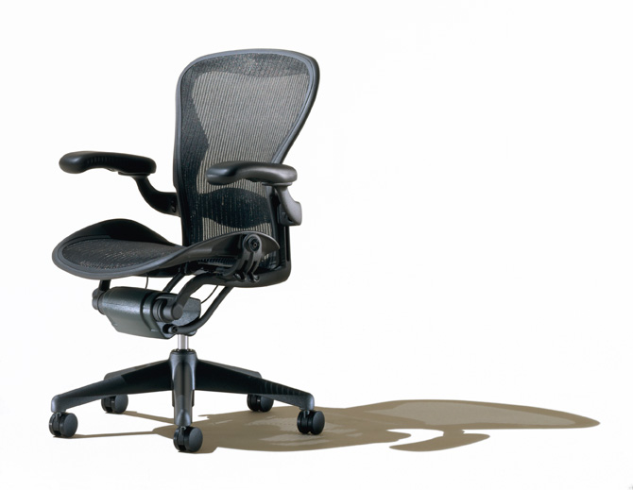
AGENDA
Company Background
Industry and Market Analysis
Customer Needs Research
10 Product Concepts
Existing Patent Search
Concept Test
Attribute Test
Potential Complications
Early Operational Challenges

Slide 3
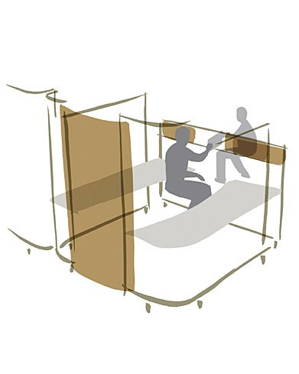
Company Background
Herman Miller
High end office furniture
Product Categories
Lighting
Organizational Accessories
Desk Accessories
Group-Use/Collaboration
Desks/Cubicles
Notes:
Focus of good design incorporating fashion and function. Lots of research of psychology in the workplace and tailoring products to make employees more productive. Long history of working with good designers. Aeron Chairs upstairs on 5th floor as example.

Slide 4
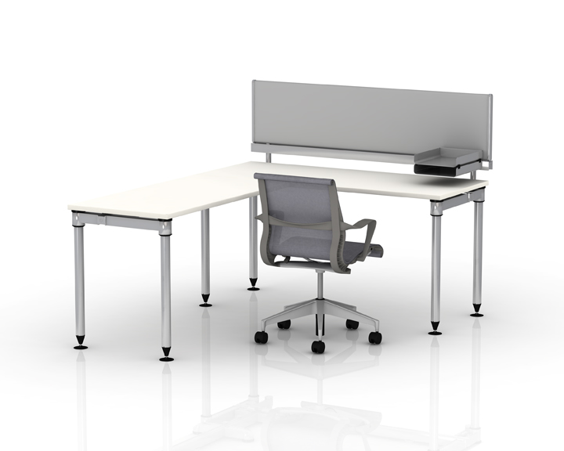
Industry and Market
Office Furniture Industry
Valued at $7.85 Billion in 2009
Projected $8.2 Billion in 2010
Highly correlated to macro-economic factors
Overall GDP
Highly Cyclical
Market Segmentation
High End
Large Corporations
End user is not the same as buyer
Distribution
Interior Designers
Architects
Direct to consumer
Notes:
Industry is growing!! Incredibly low compared to 2005-6 = $11BILLION. ANALOGY: Of normal furniture is to housing market.
High vs. Low End. Large Company vs. Start up. End User = Office Worker Buyer= Facility Manager. Need to meet user needs but also appeal to facility manager.

Slide 5
Notes:
For a detailed analysis the paper: Determining Industry -> assigned by Mcdermott, we chose Herman Miller as our parent company. Gather Evidence -> exploratory research, this included Monkey survey, Google Survey, Phone Interviews, one-on-one interviews, visit local companies Accent Furniture, Tech Valley Office Furniture. Analyze results, by doing a gap-analysis and overall perceptual similarities tests. Interpret evidence was based on the gap analysis to start our concept testing. Segment our market from the evidence we obtained. Send more surveys establishing our concepts tests highlighting the wants and needs from customers. Establish a product winner from concept tests.

Slide 6
Highlights From Consumers
Active papers are in semi-organized piles on my desk, and I would prefer a better solution for this.” Anonymous (Survey Monkey)
“My co-worker who I share an office with is very cluttered” Anonymous (Survey Monkey)
“My work area is my holy sacrament, and I cannot work in a disrupted environment, a dirty environment, a messy desk...” Pleasant DeSpain (Author)
“…. never having a synchronized way of organizing current projects.” Rod Dion CEO of Tech Valley Furniture
“Its really annoying looking at my messy desk, but I can’t help it…” Michael Gleasman CEO of Accent Furniture
Notes:
This is self explanatory just read the comments. Anecdotes that organization is most important customer need.

Slide 7
Short Interview Clip
Mr. Pleasant DeSpain
Occupation: Author
Mr. Pleasant DeSpain
405 3rd St., Troy, NY 12180
email: pleasant@storypro.com
http://www.storypro.com/index.html
Notes:
Audio Clip: Click to play
Organization is vital, doesn’t want to have to search for papers, still paper oriented

Slide 8
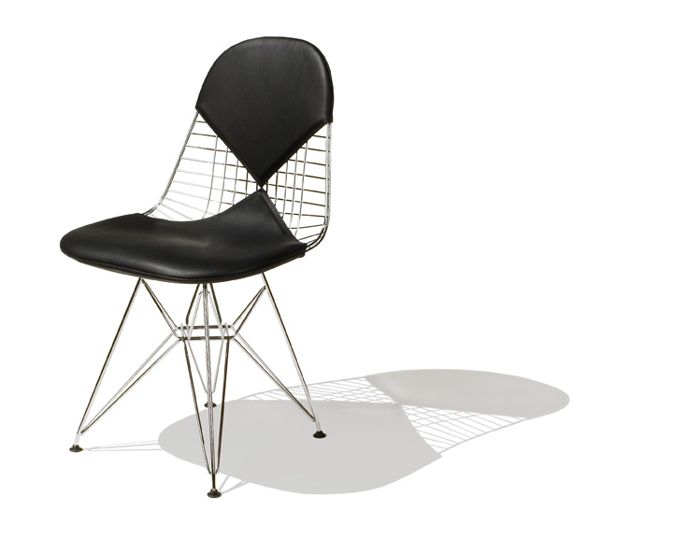
Identified Customer Needs
Organization
Paper Documents
Cable Management
Binders / Notebooks
Pens, Pencils, Supplies etc.
Open Office
Employee behavior
Employee Interaction
Group Use/Collaboration
On the fly meetings
Lighting Control
Customizable
Direction
Quality (Daylight VS. Interior Lighting)
Notes:
Notes: We used a qualitative survey to help identify the needs of consumers.
We asked them what they like and dislike about their office and if their company had taken steps to improve team collaboration. We also asked about their office lighting situation, how they stay organized and whether these could be improved. Also, we asked about how people stay alert. Finally, we asked an open ended question which helped highlight some of those burrrning needs of office workers.
(give a quick summary of the qualitative survey as outlined above).

Slide 9
10 Product Concepts
1. Conference table with rail system : Rail system for plugging in electronic devices
2. SMART partition : Portability, built-in projector, interactivity
3. SMART file cabinet : LCD display on filing cabinet for managing files
4. LED wall mount light : Periodically changes to mimic natural light
5. Mess manager : Modular desk organization using rotating wheel
6. Task light : Expandable/Adjustable light beam
7. Rubber chair wheels : Attachable rubber wheels to retrofit office chair
8. Idea couch : Couch with fold out table/pen for ideation
9. Privacy Speaker : Muffle unamplified voices
10. Dry erase desk : Slide-able surface for enhanced privacy/security
Notes:
TALK ABOUT SMART PARTITION/ PRIVACY SPEAKER/ MESS MANAGER

Slide 10
Patent Search on Product Concepts
Iterative Procedure
1) …Generate product concept ideas based on identified user needs
2) Conduct patent search and product search
(via www.USPTO.gov and www.ibm.com/ibm/licensing/
(via search engines such as Google)
3) Keep unique product concepts and throw out product concepts that were found to have patent protection and/or are already on the market.
Examples: USB powered task light and wireless power charging hub
4) Repeat from Step 1
5) Stop when all generated product concepts are deemed unique and/or offer significant improvement over current products on the market.
6) Move on to concept testing…
Following this iterative procedure, our final 10 product concepts were found to be unique.
Notes:
Notes: Every time we generated a group of ideas according to user needs, we made sure to conduct a patent search on similar products to ensure legal propriety and competitive advantage. We also conducted searches using Google for similar product offerings.
Following this iterative procedure of generating product concepts and conducting a search for the product via patent networks and search engines, we are confident that our final 10 product concepts are unique and will offer significant competitive advantage

Slide 11
Concept Test
 | Each 25% | Like 40% | Unique 40% | Buy 40% | CADWO 40%
Conference Table w/ rail system | 57 | 61.6 | 58.2 | 57.8 | 50.4
SMART Partition | 60.25 | 64.2 | 63.4 | 60.6 | 52.8
SMART File Cabinet | 64.25 | 66.4 | 68.6 | 64.4 | 57.6
LED Wall Mount Light | 59.25 | 60.2 | 63.8 | 60 | 53
Mess Manager | 65.75 | 68.4 | 69.6 | 65.8 | 59.2
Task Light | 56.25 | 60.2 | 57 | 58.4 | 49.4
Rubber Chair Wheels | 49.75 | 52.6 | 52.6 | 50.8 | 43
Idea Couch | 49.25 | 53 | 51.8 | 49.4 | 42.8
Privacy Speaker | 60.25 | 63.6 | 64.4 | 60.6 | 53.4
Dry Erase | 56.75 | 61 | 60.8 | 57.2 | 48
Notes:
Among the 10 product ideas, the mess manager is the clear winner, closely following by SMART file cabinet. In our 16 valid questionnaires, the occupations of our respondents are diversified: dentist, writer, engineer, lawyer, architect, social worker, banker, etc. In regarding to some products such as SMART partition and rubber chair wheel, respondents rate very differently. But all respondents demonstrated a strong interest in products that helping organizing office space. Thus, it is not hard to draw a conclusion that the need for organization in an office context is at the top.
As the results of 10 product ideas are somewhat close, in order to select the winner of 10 product ideas effectively, we set the weight of 4 questions in different values. First, we evenly distributed the weight, each 25%. Then we increased the weight of one of the factors to 40% and weights of other factors remained even distributed. All the results reveal that mess manager is the winner no matter priority of 4 factors changes.

Slide 12
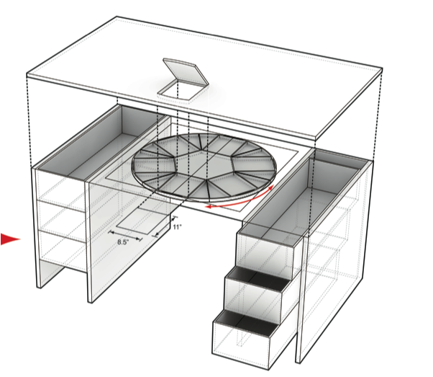
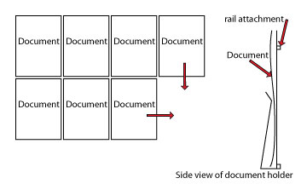
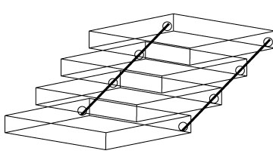
Potential Product Designs
Notes:
Under the desk LAZY SUSAN style rotating file holder
Wall-mounted rail system allows documents/notepads to be held in document holders which move in 2 dimensions along the railsystem
Cascading file: operates like a tackle box push back to open when closed looks just like a rectangular box

Slide 13
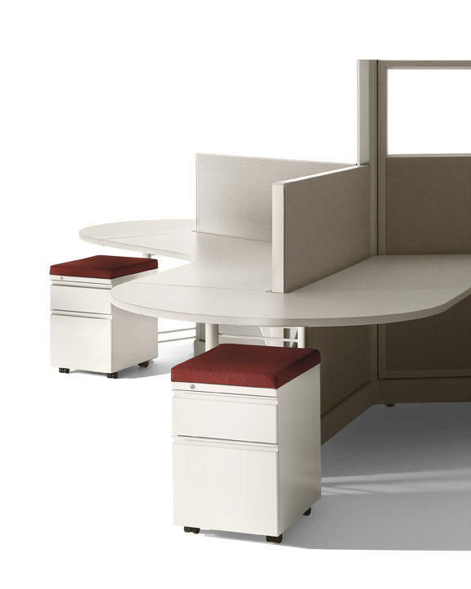
Attribute Test
Six Attributes Tested
Document Visibility
Capacity
Location on desk
Aesthetic
Price
Functionality
64% of respondents value functionality most
Prefer that product be easy to self install
Design for assembly
Prefer that it hold more than papers
Notebooks
Laptop
Binders
Notes:
Got our attributes from additional interviews from people who did the concept test.

Slide 14
Estimating Market Potential
Chain Ratio Method
Mess Manager: Directed at office workers who prefer better organization of papers and office supplies at desk:
$10,000,000,000 Approximate Amount of Office Furniture sales (averaged over past five years) * .30 Proportion of office furniture that includes tables, desks, and filing cabinets $3,000,000,000 * .70 Proportion of office workers that still use paper (as opposed to purely electronic) – 70% from survey $2,100,000,000 * .75 Proportion of office workers that want better organization at desk – 75 % from survey $1,575,000,000 Industry Potential Sales (Market Potential) * .005 Estimated Long Run share for Mess Manager $7,875,000
Even based on a half of a percent market share for Herman Miller with this product, it is still forecasted to generate $7.875 million in sales!

Slide 15
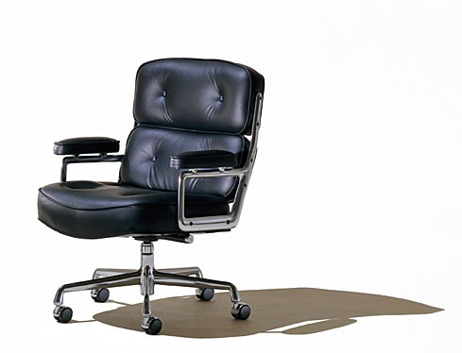
Potential Complications/Challenges
Safety
Reduce hazards
Marketing
Distribution channel
Consistency with company values
Ability to access documents
Paper jams
Product Disposal
Substitute products
Users going paperless
Notes:
Desk mounted design may fall on your legs. Herman Miller values green products. Possibly made of recycled components.

Slide 16
Early Operational Considerations
Flow Shop Production = Feasible
Technological Complexity = Low
Material Selection determines skills, workers, and equipment needed
Additional Considerations:
Tradeoff between Aesthetics and Functionality
Components to Outsource vs. Make In-House
Notes:
FLOW SHOP used because ONE product is produced over and over. Herman Miller values aesthetics and good design but we want to make sure we do not sacrifice too much functionality.

Slide 17
Conclusion
Through in depth surveys, interviews and data analysis it is clear that the ‘Mess Manager’ will be our product.
Going Forward
Conduct more attribute testing to determine best product design
Design prototypes or mock-ups for user critique
Establish a flow-shop process and procedure for our product

Slide 18
Questions

Slide 19
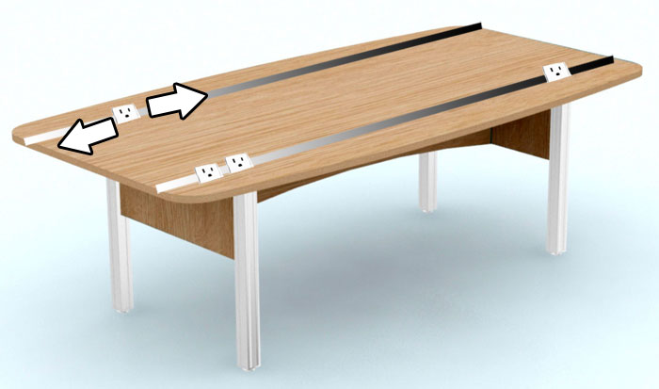
1. Conference table with rail system
Moveable outlets allow users to sit wherever they like

Slide 20
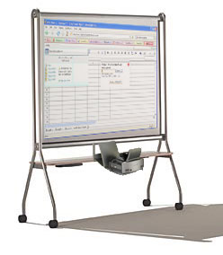
2. SMART partition
Portable Interactive Partition for meetings on the fly

Slide 21
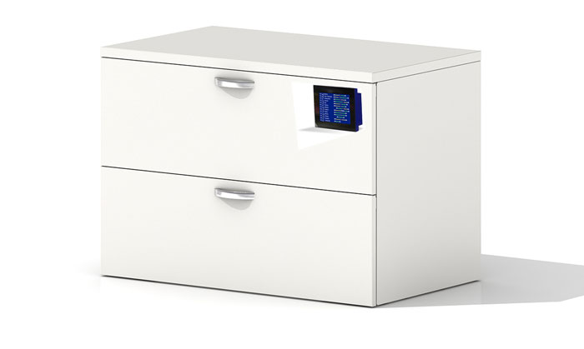
3. SMART file cabinet
Organizing with SMART information system

Slide 22
4. LED wall mount light
Provide psuedo-sunlight for offices without a window

Slide 23
5. Mess manager
Organizing files at fingertip

Slide 24
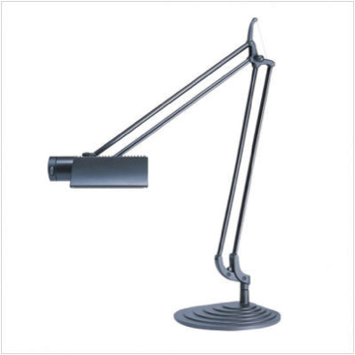
6. Task light
Allows user to focus light better

Slide 25
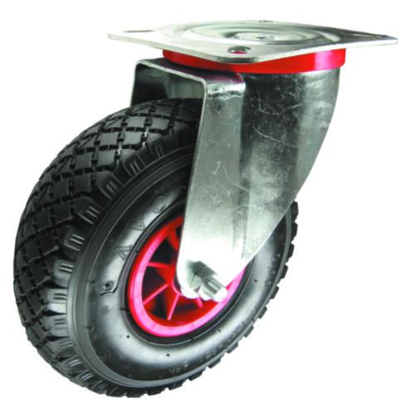
7. Rubber chair wheels
Allows chair to roll on multiple surfaces

Slide 26
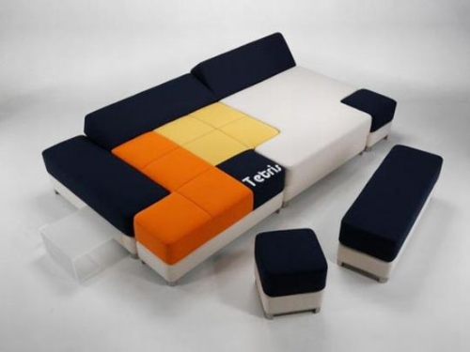
8. Idea couch
A place for ideation with integrated desk/pencil cup in order to make sure you can write down what you have thought up.

Slide 27
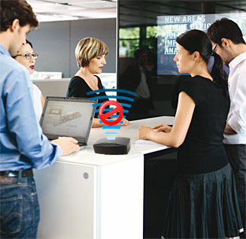
9. Privacy Speaker
Reduce meeting noise

Slide 28
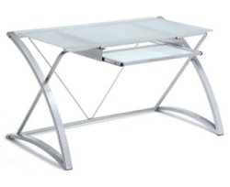
10. Dry erase desk
Easy place to take notes

